Slide 1
Learning Support Coordinators and Tiwhikete Whakaakoranga Tūturu Full (Category One) Practising Certificates
Notes:
Tęnā koutou katoa
Ko Takatima te pae maunga
Ko Aparima te awa
Ko Otautau takiwā
E noho ahau ki Te Whanaganui-a-Tara
Ko Chris Thornley tōku ingoa
Kei te mahi au i Matatū Aotearoa
In my role, I work with the profession on Our Code Our Standards, Ngā Tikanga Matatika, Ngā Paerewa and the professional growth cycle
I am pleased to take this opportunity to introduce you to the work we at the Teaching Council have undertaken with the Ministry of Education and some of the Learning Support Coordinators to ensure all LSC. can maintain their Tūturu Full (Category One) practising certificates.
We also refer to the resource we have produced and published on the Teaching Council website to support this process
Ki te mihi mahana ki a koutou katoa

Slide 2
Our Code Our Standards Ngā Tikanga Matatika Ngā Paerewa
Teaching Council Matatū Aotearoa, Ministry of Education and Learning Support Coordinators (LSC) worked together
Understand the LSC role in relation to:
Our Standards
Ngā Paerewa
Notes:
In late 2020, the Teaching Council Matatū Aotearoa worked with the Ministry of Education and a group of Learning Support Coordinators (LSCs) to understand how teachers or kaiako working in a Learning Support Coordinator role can maintain a Tuturū Full (Category One) practising certificate. It needed to be ascertained that within their role, the LSC is able to use and meet the Standards for the Teaching Profession or Ngā Paerewa mō te Umanga Whakaakoranga (in English and Māori medium contexts respectively).

Slide 3
Analysis of Role Description
To hold a Tūturu Full (Category One) Practising Certificate, a teacher must use and meet all of the:
Standards In English medium
Paerewa in Māori medium.
The Council analysed the role description for LSCs finding that it addresses all of the Standards or Paerewa.
Notes:
The Council analysed the LSC Role Description in relation to the Standards and Paerewa.
It was necessary to see that the Role Description included actions, knowledge, professional attributes and values of the Standards or Paerewa.
A matching up task was undertaken to be sure that each of the six standards were visible for English medium LSC and each of the six Paerewa were visible for Māori medium LSC.
An important outcome for LSCs and their employing principal or tumuaki is that the:
This matching up task illustrated an alignment showing that anyone successfully working in this role (be it in English medium or Māori medium) could maintain a Tuturū Full (Category One) practising certificate.

Slide 4
Standards and Paerewa in each context
Standards and Paerewa are expected to be interpreted for each setting to reflect the quality teaching practices that teachers will use in that setting.
Standards and Paerewa can also be interpreted to give clarity for specific roles such as LSC, RTLB….
A quality practice template can be used to record these but is not compulsory.
Notes:
In Aotearoa, we have a single set of Standards or Paerewa for all positional leaders and teachers.
There are only 6 Standards and 6 Paerewa and these apply to all teachers irrespective of where they teaching, the age of their learners, the priorities of the school, kura and communities they serve.
This is because the profession is trusted to use nationally available frameworks and policies to inform how they contextualise the Standards and Paerewa for their setting.
The outcomes of this process is often recorded on the Council’s Quality Practice Template (but the recording formats can be used),
This is such an important part of working with the Standards and Paerewa that it is reflected in element a of the professional growth cycle.
It may be helpful to use this approach for the LSC roles but it is not compulsory.

Slide 5
A significant difference…
For LSC, the learners will often be teacher colleagues rather than children
This has significance for all of the Standards or Paerewa and is most obvious when considering how the LSC:
develops the learning focused culture
thinks about designing the learning for adults
and teach.
Notes:
The LSCs learners are often not students or children but teacher colleagues. This means that they meet and use the Standards or Paerewa as they work with (and teach) adults.
This also occurs for a range of other roles for examples principals, tumuaki, RTLB or teachers in initial teacher education.
This has implications particularly for how they create a Learning Focused Culture, Design the Learning and how they Teach. Learning Support Coordinators will need to consider how these look within and inform their roles.
Being conscious of the Standards in their roles will become a natural part of the professional growth cycle too where the elements emphasise not only meeting but using the Standards.

Slide 6
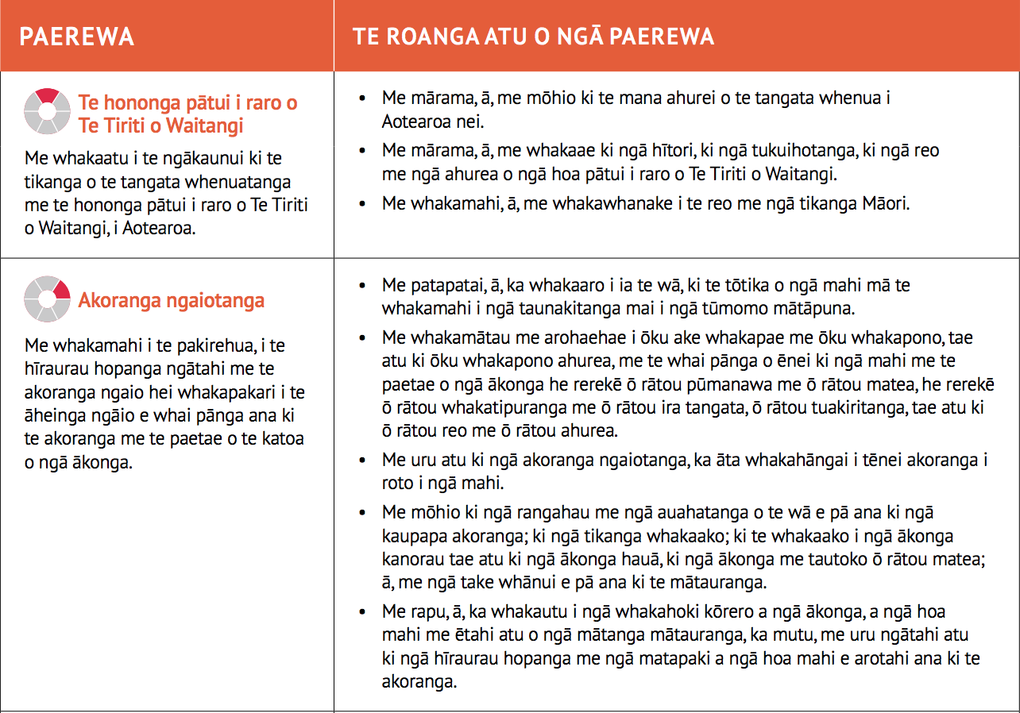
Using the Standards and Paerewa for LSC in English and Māori medium schools and kura
For English medium, here are the Standards their elaborations and LSC contextual interpretation:
https://teachingcouncil.nz/assets/Files/For-teachers/Learning-support-coordinator-matrix-document.pdf
For Māori medium, ngā Paerewa and their elaborations here:
https://teachingcouncil.nz/assets/Files/Code-and-Standards/Our-Code-Our-Standards-Nga-Tikanga-Matatika-Nga-Paerewa.pdf
Notes:
Information for LSC and their Employing Principals
For LSCs in English medium settings, the alignment between the Standards with elaborations and the Role Description has now been presented in a matrix available on the Teaching Council website. There are also Quality Practice examples provided by some LSCs showing their contextual interpretation of the Standards in the work of LSCs in different settings. These are indicative and not compulsory in LSC practice.
For LSCs in Māori medium settings, the Paerewa and Role Description are aligned, but have not YET been developed into a matrix. Similarly, Eexamples of contextual interpretation have not been developed. LSCs from Māori medium contexts sought a longer timeframe to be clear about how Role Description, the Paerewa fit to one and other.
For this reason, the Council requests that the in the interim, elaborations related to each Paerewa written in Our Code, Our Stadnards, Ngā Tikanga Matatika, Ngā Paerewa (p p 19 and p 21) and available on the Teaching Council website be used as indicative of how the LSCs demonstrate the Paerewa.
As with the English medium Quality Practice examples, it is not expected that every elaboration would be visible, these are indicative and expected to be representative not compulsory in LSC practice.

Slide 7
Employing principals, tumuaki and LSC: planning the professional growth cycle
Steps for the PGC include:
Employing school, kura, principals or tumuaki and their LSC will have common understanding of the Standards or Paerewa and what meeting them as LSC in their context looks like.
With the principal or tumuaki, LSCs will plan and participate in a cycle of professional growth.
As part of the PGC, the LSC will have the opportunity to learn, grow and discuss their practice and receive feedback.
The employing school, kura, principal or tumuaki will confirm annually whether (or not) the LSC meets the Standards or Paerewa.
Notes:
In this slide, there is an abbreviated overview of the PGC elements as they specifically relate to the LSC role. The resources include the complete set of elements that provide the basis for this slide that overviews the process.
For all teachers and kaiako in these roles, participation in a professional growth cycle is required and endorsement decisions are based on the LSC’s practice as required for the Tuturū Full (Category One) practising certificate.
I shall explain this a little further here:
Employing school, kura principals or tumuaki and their LSC will have common understanding of the Standards or Paerewa and what meeting them as LSC in their context looks like. For English medium some examples have been included in the resource here.
With the principal or tumuaki, LSCs will plan and participate in a cycle of professional growth.
As part of the PGC, the LSC will have the opportunity to learn, grow and discuss their practice and receive feedback.
The employing school, kura, principal or tumuaki will confirm annually whether (or not) the LSC meets the Standards or Paerewa.
The endorser for a teacher in this role will be the employing principal or tumuaki.

Slide 8
Find further information on TC website
LSC resource https://teachingcouncil.nz/getting-certificated/for-teachers/working-as-learning-support-coordinators/
PGC webinar https://teachingcouncil.nz/professional-practice/professional-growth-cycle/professional-growth-cycle-zoom-webinars/
Endorser Guideline https://teachingcouncil.nz/professional-practice/professional-growth-cycle/The English medium LSC matrix can be found
Contact us: letstalk@teachingcouncil.nz
Notes:
All of these resources relate to this topic and can be found on the Teaching Council website.
What really matters here is that this
It is intended to be a straightforward process that recognises the LSC role as one where teachers can hold the Tūturu Full Category One Practising Certificate.

Slide 9
Acknowledgements
Thank you to all the Learning Support Coordinators who:
participated in the conversations with us to support a way forward for certification,
tested ideas and thinking with colleagues,
provided feedbac and some examples to indicate how the role reflects the Standards and Paerewa.
Thank you to the Ministry of Education who facilitated our engagement with the LSC and provided guidance as we advanced the work together.

